Slide 1
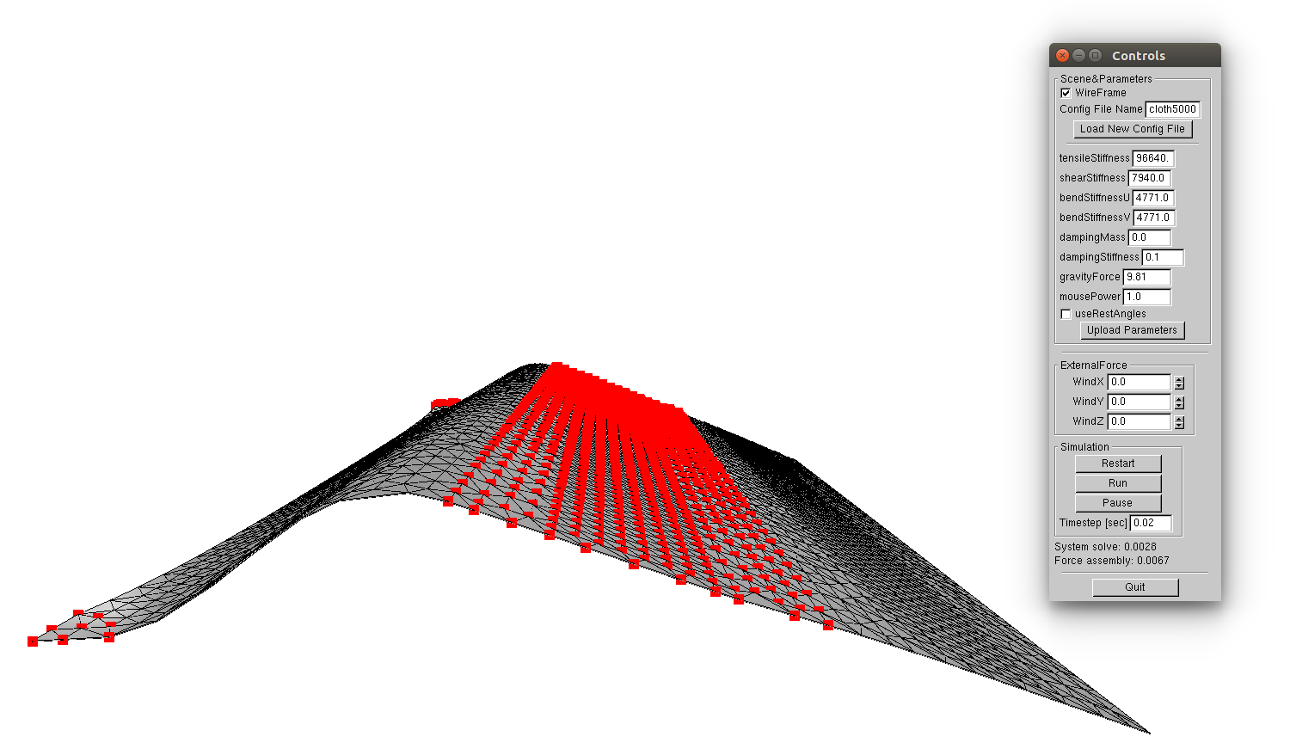
SurfaceDensity = 2.47e-5
TotalMass = 8.5
TensileStiffness = 9.664e4
ShearStiffness = 7.94e3
BendStiffness = 4.771e3
BendStiffness = 4.771e3
DampingMass = 0
DampingStiffness = 0.1

Slide 2
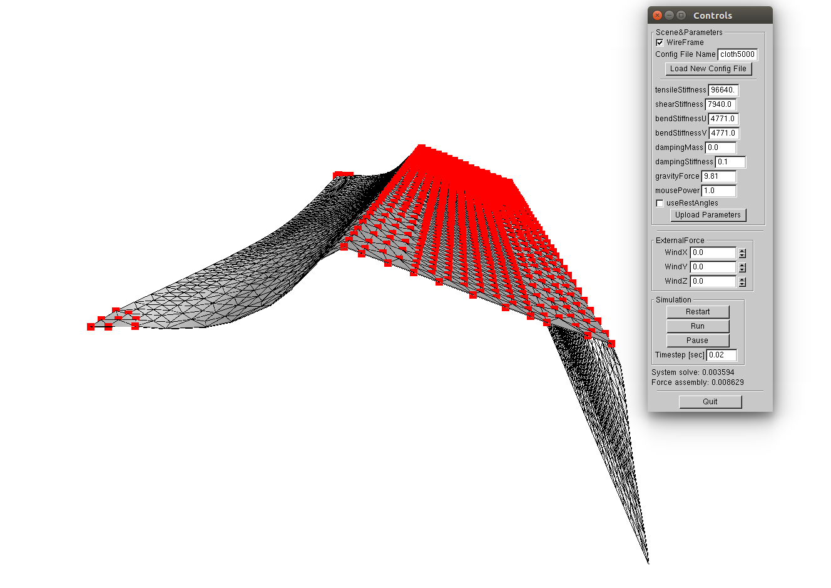
SurfaceDensity = 2.47e-2
TotalMass = 8541.97
TensileStiffness = 9.664e4
ShearStiffness = 7.94e3
BendStiffness = 4.771e3
BendStiffness = 4.771e3
DampingMass = 0
DampingStiffness = 0.1

Slide 3
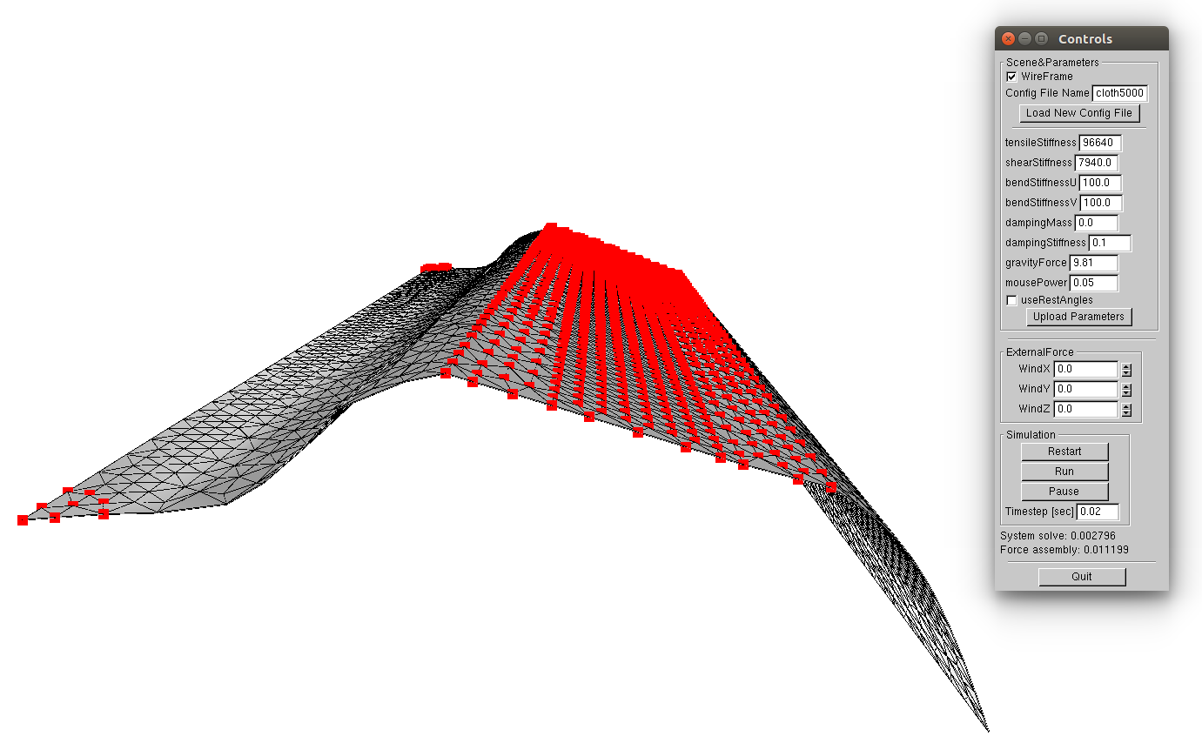
SurfaceDensity = 2.47e-5
TotalMass = 8.5
TensileStiffness = 9.664e4
ShearStiffness = 7.94e3
BendStiffness = 100
BendStiffness = 100
DampingMass = 0
DampingStiffness = 0.1

Slide 4
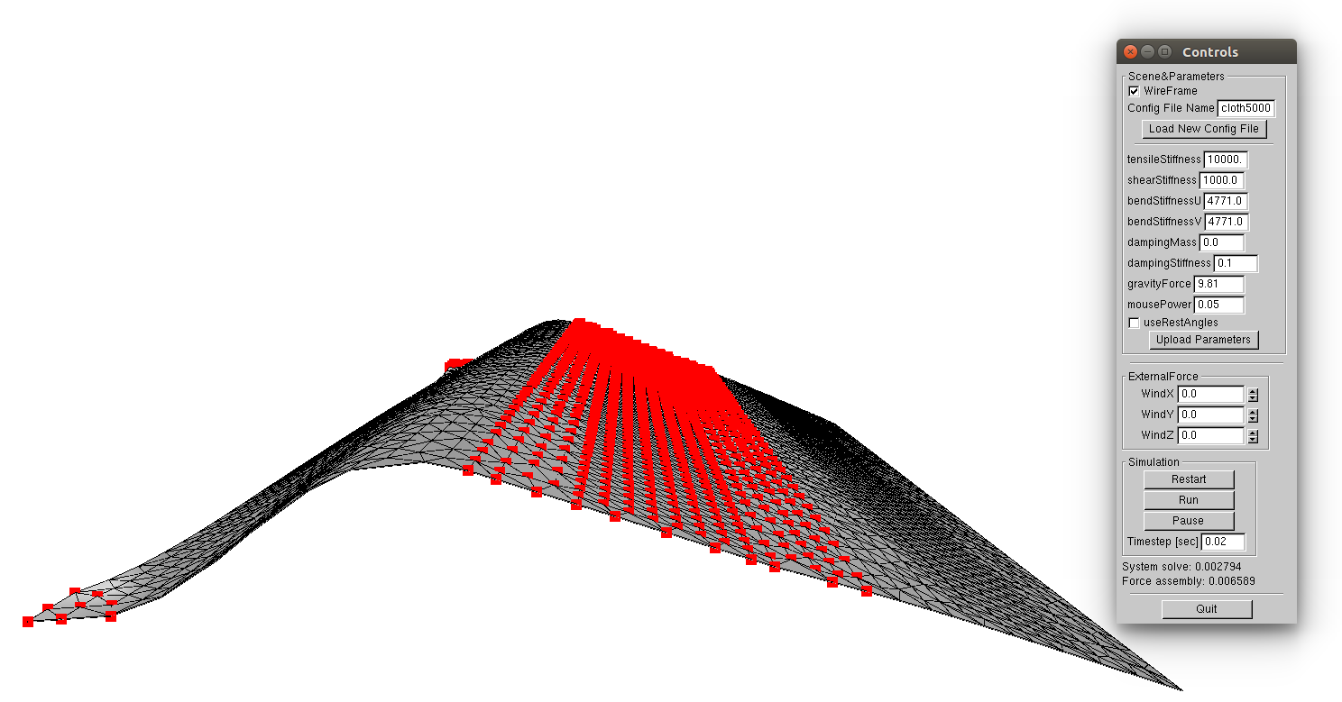
SurfaceDensity = 2.47e-5
TotalMass = 8.5
TensileStiffness = 10000
ShearStiffness = 1000
BendStiffness = 4.771e3
BendStiffness = 4.771e3
DampingMass = 0
DampingStiffness = 0.1

Slide 5
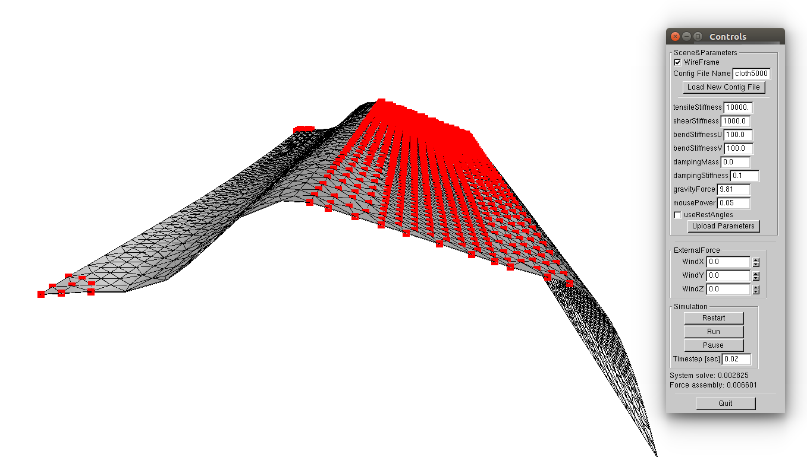
SurfaceDensity = 2.47e-5
TotalMass = 8.5
TensileStiffness = 10000
ShearStiffness = 1000
BendStiffness = 100
BendStiffness = 100
DampingMass = 0
DampingStiffness = 0.1

Slide 6
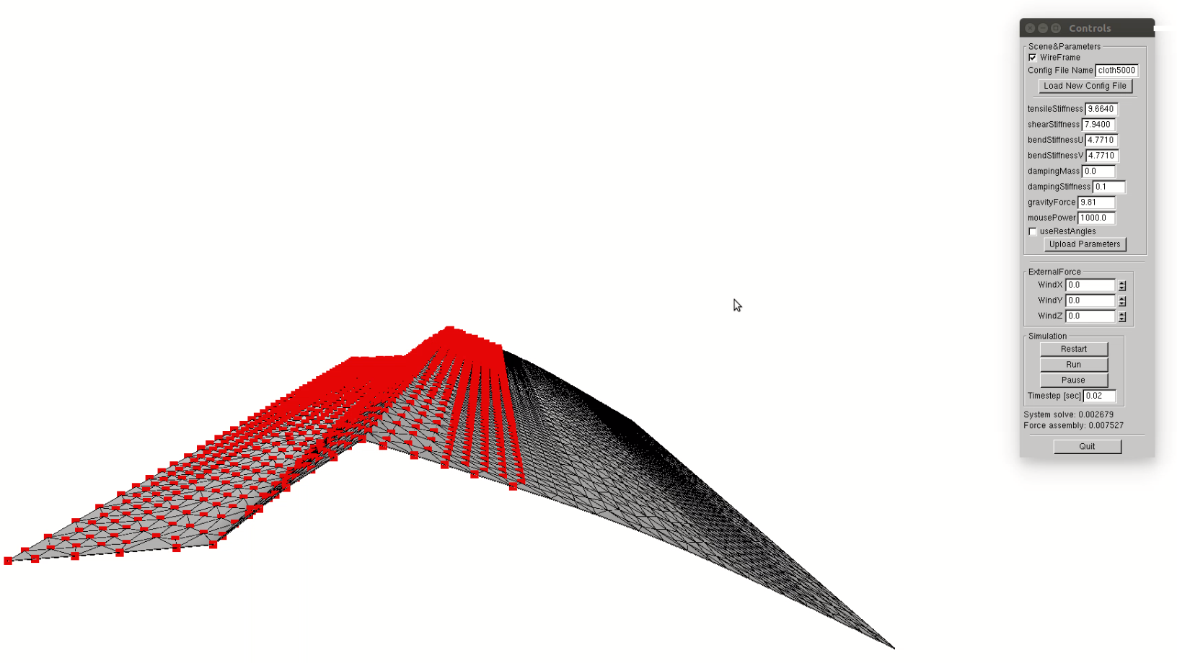
SurfaceDensity = 2.47e-2
TotalMass = 8541.97
TensileStiffness = 9.664e4
ShearStiffness = 7.94e3
BendStiffness = 4.771e3
BendStiffness = 4.771e3
DampingMass = 0
DampingStiffness = 0.1
At Rest

Slide 7
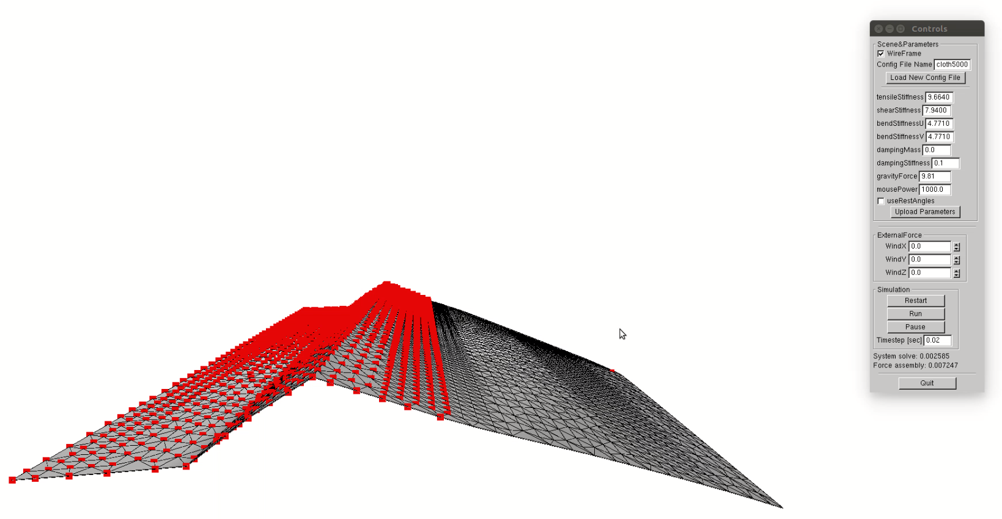
SurfaceDensity = 2.47e-2
TotalMass = 8541.97
TensileStiffness = 9.664e4
ShearStiffness = 7.94e3
BendStiffness = 4.771e3
BendStiffness = 4.771e3
DampingMass = 0
DampingStiffness = 0.1
Motion 1

Slide 8
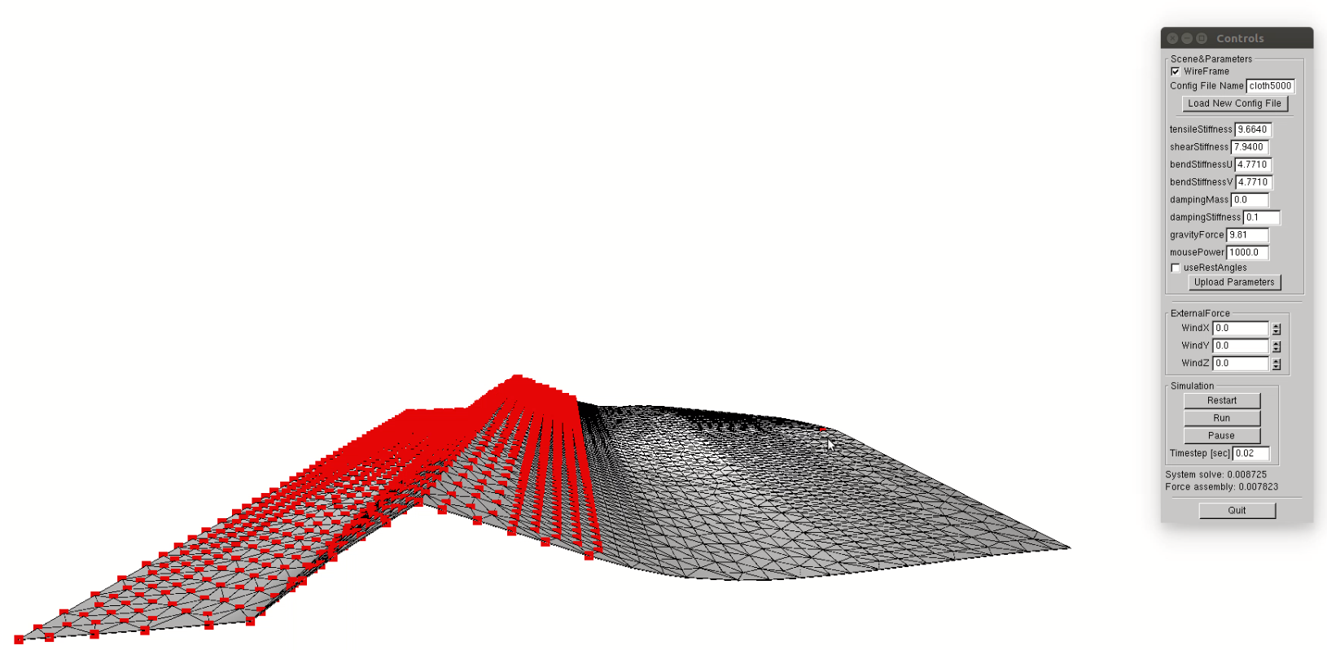
SurfaceDensity = 2.47e-2
TotalMass = 8541.97
TensileStiffness = 9.664e4
ShearStiffness = 7.94e3
BendStiffness = 4.771e3
BendStiffness = 4.771e3
DampingMass = 0
DampingStiffness = 0.1
Motion 2

Slide 9
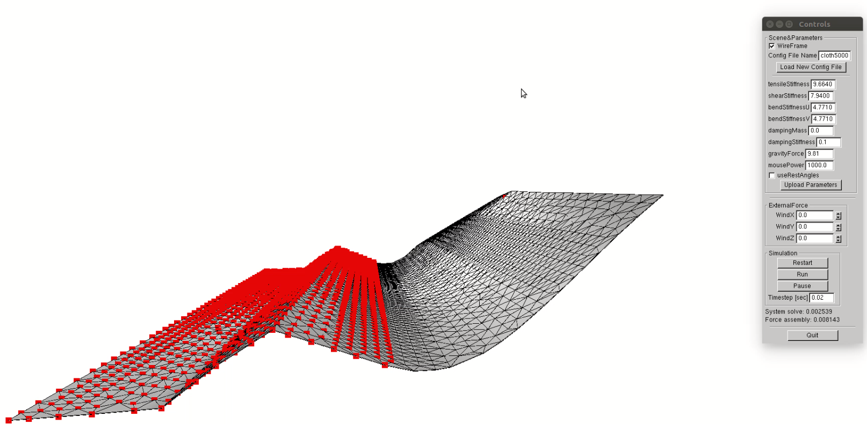
SurfaceDensity = 2.47e-2
TotalMass = 8541.97
TensileStiffness = 9.664e4
ShearStiffness = 7.94e3
BendStiffness = 4.771e3
BendStiffness = 4.771e3
DampingMass = 0
DampingStiffness = 0.1
Motion 3

Slide 10
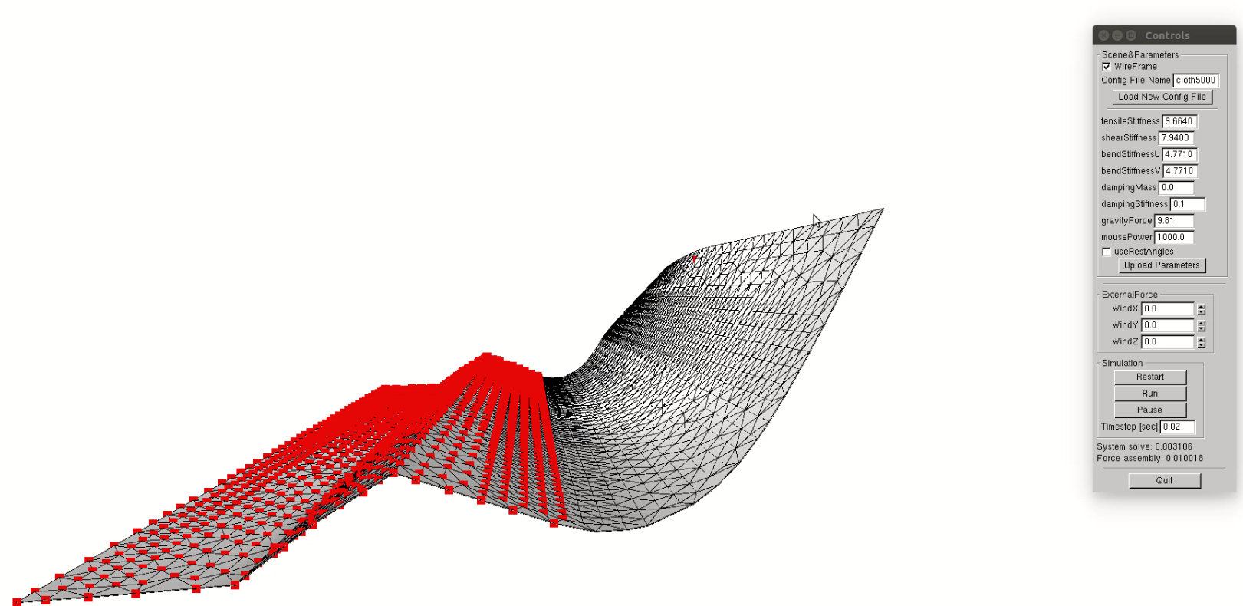
SurfaceDensity = 2.47e-2
TotalMass = 8541.97
TensileStiffness = 9.664e4
ShearStiffness = 7.94e3
BendStiffness = 4.771e3
BendStiffness = 4.771e3
DampingMass = 0
DampingStiffness = 0.1
Motion 4

Slide 11
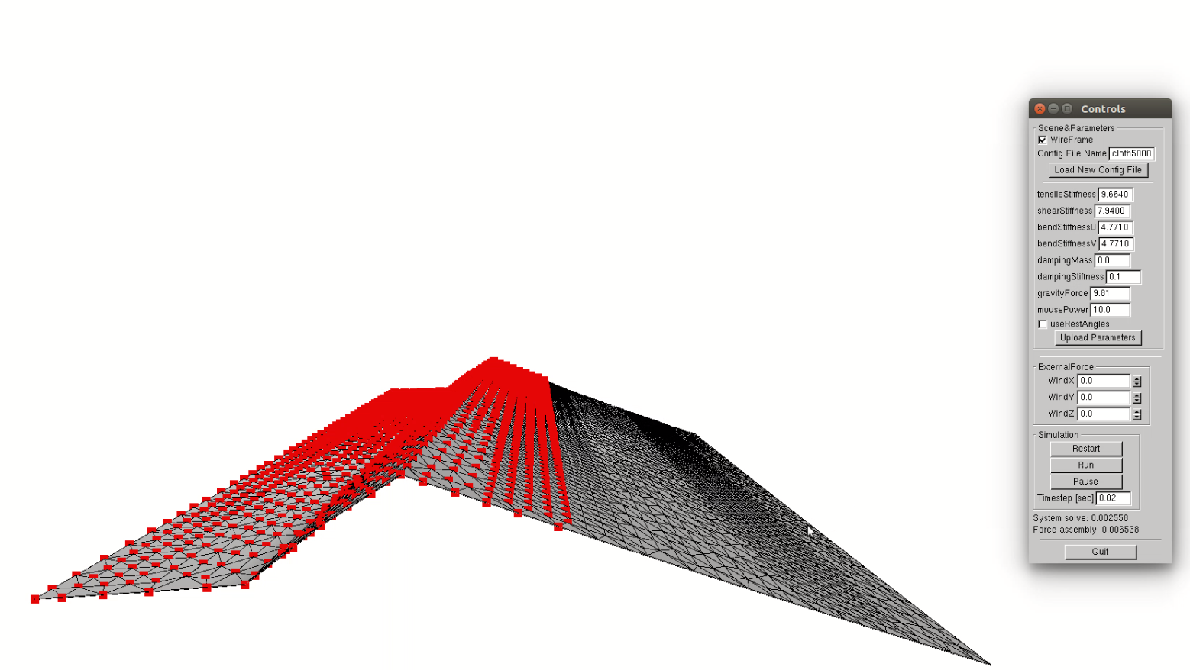
SurfaceDensity = 2.47e-5
TotalMass = 8.5
TensileStiffness = 9.664e4
ShearStiffness = 7.94e3
BendStiffness = 4.771e3
BendStiffness = 4.771e3
DampingMass = 0
DampingStiffness = 0.1
At Rest

Slide 12
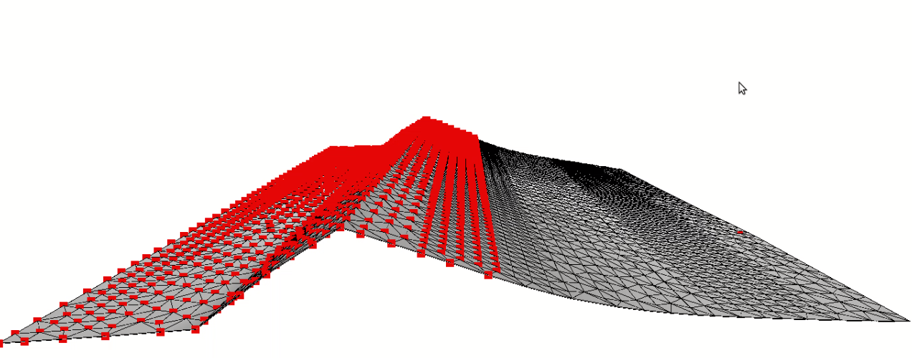
SurfaceDensity = 2.47e-5
TotalMass = 8.5
TensileStiffness = 9.664e4
ShearStiffness = 7.94e3
BendStiffness = 4.771e3
BendStiffness = 4.771e3
DampingMass = 0
DampingStiffness = 0.1
Motion 1

Slide 13
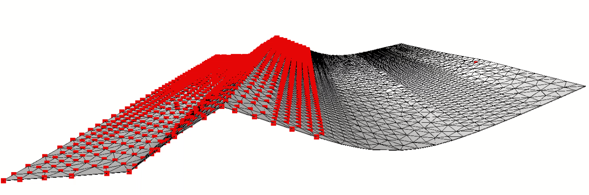
SurfaceDensity = 2.47e-5
TotalMass = 8.5
TensileStiffness = 9.664e4
ShearStiffness = 7.94e3
BendStiffness = 4.771e3
BendStiffness = 4.771e3
DampingMass = 0
DampingStiffness = 0.1
Motion 2

Slide 14
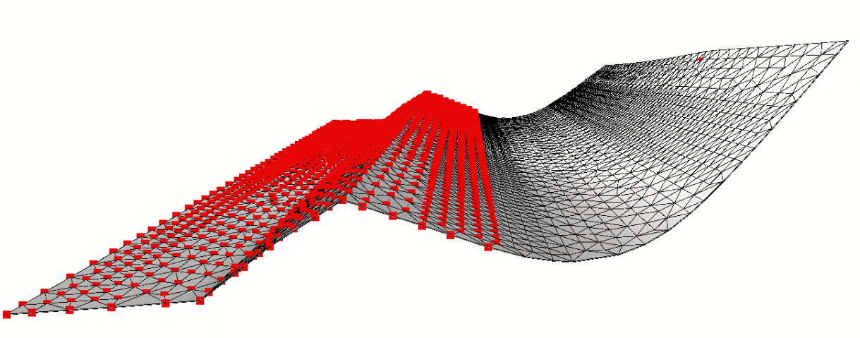
SurfaceDensity = 2.47e-5
TotalMass = 8.5
TensileStiffness = 9.664e4
ShearStiffness = 7.94e3
BendStiffness = 4.771e3
BendStiffness = 4.771e3
DampingMass = 0
DampingStiffness = 0.1
Motion 3

